Slide 1
Judgment

Slide 2
Now that all has been heard, here is the final conclusion: Fear God and obey his commandments, for this is the whole duty of man. For God will bring every deed into judgment, including every secret thing, whether good or evil.
- Ecclesiastes 12:13-14

Slide 3
The Judgment is God’s response to man’s behavior.

Slide 4
“I continued watching until thrones were placed and an Ancient of Days sat; his clothing was like white snow and the hair of his head was like pure wool and his throne was a flame of fire and its wheels were burning fire. A stream of fire issued forth and flowed from his presence; thousands upon thousands served him and ten thousand upon ten thousand stood before him. The judge sat, and the books were opened.
- Daniel 7:9-10

Slide 5
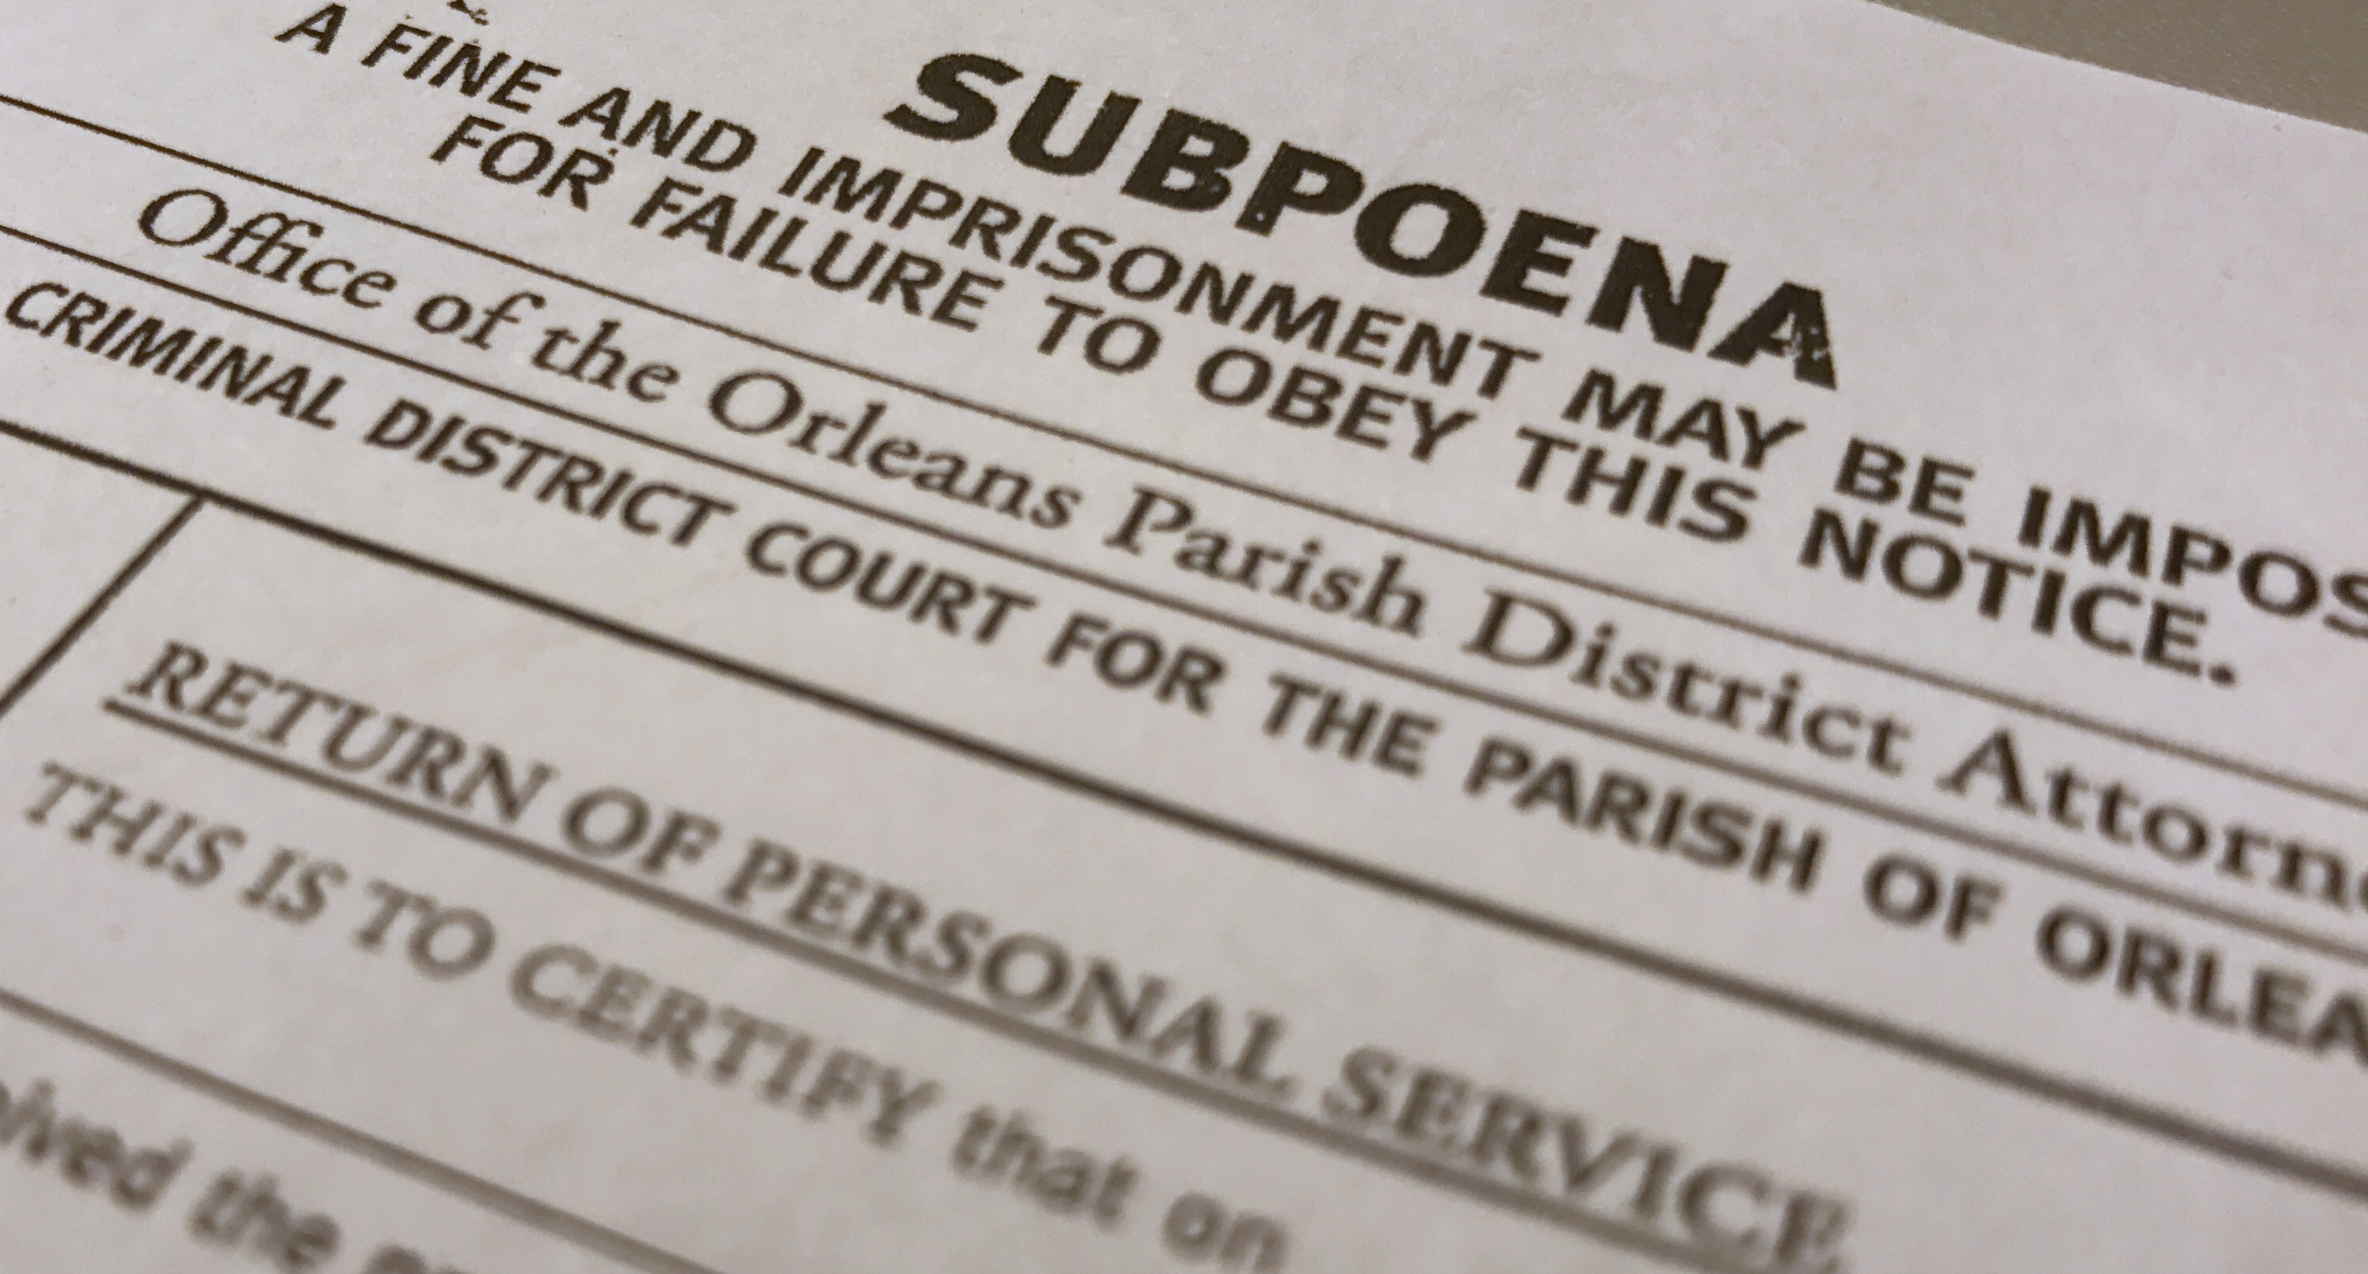

Slide 6
The Judgment

Slide 7
Key Questions About The Judgment
When is it?
Who is being judged?
Who is going to be the judge?
What am I being judged for?
What are the sentences handed out?

Slide 8
When is the Judgment?
Matthew 24; Hebrews 9:27
There is never a certain date when God may arrive
We need to be ready and prepared at anytime
When we die, the only thing left is judgment

Slide 9
Who is being Judged?
Romans 14:10-11; Acts 24:25
Every single person will have to be in judgment
That should cause some level of concern
It should affect our judgment of others

Slide 10
Who is the Judge?
Acts 17:30-31; Romans 2:16; 2nd Timothy 4:1
God is the ultimate judge of mankind
He has given Jesus the authority to judge
It should affect our judgment of others

Slide 11
What am I being judged for?
2nd Corinthians 5:9-10, Matthew 25:14-46; James 2:20
Our salvation is through faith in Jesus
Our faith is seen through supporting actions
Those actions will be weighed in the judgement

Slide 12
What are the sentences handed out?
Matthew 25, Heb. 10:31, Rev. 21:8, 2nd Thessalonians 1:9
Punishment or Paradise is going to be eternal
Satan himself will be judged
Separation and torment vs Relationship and rest

